Slide 1
The Minimum Standards for Child Protection in Humanitarian Action
CPMS
SLIDE DECK
Notes:
Facilitators:
This briefing is for any potential user of the CPMS. It is geared primarily toward child protection staff, so consider broadening some questions or providing more detail, if colleagues from other sectors join you.
It is assumed that the group is about 20 people and that everyone in the room knows each other (perhaps colleagues from your agency or the CP coordination group). if not, add 5 minutes for quick introductions.
PREPARE: a flipchart with the objectives of the session
By the end of the session, participants will be able to:
Describe the structure and content of the CPMS, especially Pillar 4
Demonstrate how & why to use the handbook
NOTE: if you have already done a Session on other CPMS Pillar(s), skip slide 2 & 9
TIP: Slides are animated -> for each click, some words, a title or an image will appear on the slide.
Read the corresponding info from the facilitators notes before showing the next point, so participants have time to process what you say, and read each point.

Slide 2

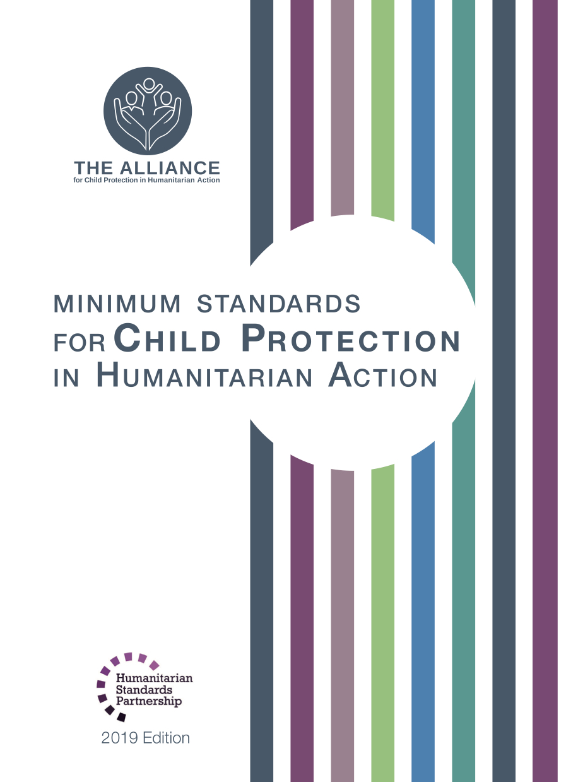

Aim of the Standards
Benchmark for CPHA
Collaborative, inter-agency tool
Links with Core Humanitarian Standard
Contextualisation for local ownership
Purpose:
  quality and accountability
  impact for children’s protection and well-being
Notes:
Donors, local governments, colleagues in other sectors and our beneficiaries themselves want to know what we are doing and why. The CPMS is our benchmark. They are the key way to operationalise or make real children's rights in the practice of humanitarian response.
The CPMS are a collaborative, inter-agency tool, that links with other initiatives, such as the Core Humanitarian Standard and the Humanitarian Inclusion Standards
Wherever relevant, the CPMS align with INSPIRE’s 7 strategies to end violence against children – initiative’s icons are actually scattered through the text. In addition, the Core Humanitarian Standard on Quality and Accountability is highlighted in the Introduction and resonates throughout the handbook.
Contextualisation is encouraged and can create ownership of the standards at every level. It can build a deeper understanding of child protection in the specific context for a wide range of actors. National coordination groups are therefore encouraged to adapt the CPMS. Please raise it with colleagues locally and then seek the guidance of the global CPMS team. You may also want to watch a short video on the Alliance’s YouTube channel
BOX: The CPMS aim at improving the quality and accountability of our programing, as well as increase impacts for children’s protection and well-being in humanitarian action (all contexts), by establishing common principles, evidence, prevention and goals to achieve. They provide a synthesis of good practice and learning to date.

Slide 3

Overview
Notes:
This is an overview of the CPMS structure: there are 28 Standards across 4 pillars and 10 CPHA principles threaded throughout.
You can find this overview on the back of the CPMS handbook or in the online handbook; it’s a practical way of locating quickly a specific topic.
This presentation focuses on Pillar 4: Standards to Work across Sectors

Slide 4

Working Together
Interconnected needs of children
Collective responsibility = Centrality of Protection
Higher-quality impact
Notes:
The CPMS have a complete section (Pillar 4) devoted to Child Protection personnel working with and learning from other humanitarian actors to improve protection and well-being outcomes for children.
This is because:
CLICK: Multisectoral approaches reflect the interconnected needs of children and emphasise
CLICK: all humanitarian actors’ collective responsibility to protect children and their families. Children’s protection risks are closely linked with the work of humanitarian actors because they have needs that fall under all sectors.
The risks children face in humanitarian crises emphasise the need to place protection at the centre of all humanitarian response = protection is the purpose and intended outcome of humanitarian action and must be at the centre of all prevention, preparedness and response actions
CLICK: Multisectoral programming - that includes and addresses child protection considerations (such as children’s particular risks, vulnerabilities, developmental stages, etc.) can be an effective way to achieve real, higher quality outcomes for both / all sectors.

Slide 5
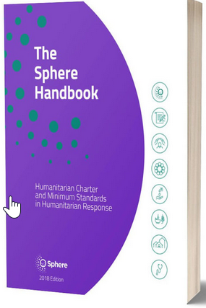

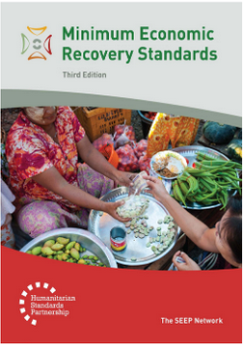
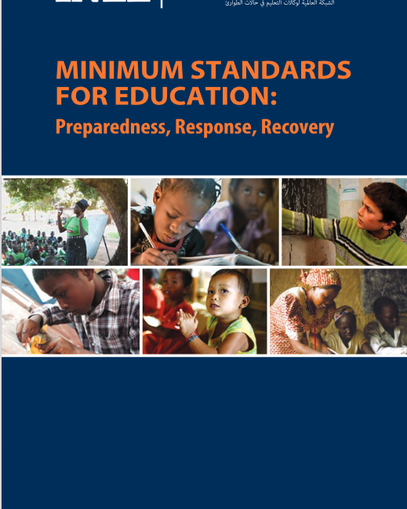
Sector-specific standards
Notes:
The CPMS provide suggested key actions for child protection and other sectoral workers related to mainstreaming and integration
They do not, however, provide sector-specific guidance for each humanitarian sector. This can be found in the relevant standards for each sector such as the Minimum Economic Recovery Standards (MERS), the Minimum Standards for Education (INEE) and the Sphere Standards. The two (or more) sets of standards should always be used in conjunction.
Discussion prompt: Can anyone name standards under Pillar 4?

Slide 6
Pillar 4 - Approaches
Approach | Implications | Aim | Considerations
Mainstreaming | Sector-specific: actions taken within a specific sector | To promote a safe, dignified and protective environment and to improve the impact the whole response by applying do no harm and proactively reducing risks and harm. | * Apply and contextualise key actions in the CPMS
Integrated Programming | Favouring collective over sector-specific planning, implementation, monitoring and evaluation. A holistic understanding of child well-being is the starting point for action, with sectoral specialties being used to meet that goal. | To achieve collective outcomes for children through deliberate, joint assessment, goal setting, planning, implementation and monitoring across sectors. | * Similar to joint-programming, but greater levels of coordination and collaboration required
Joint Programming | Sectors maintain their own sector’s objectives while jointly planning and implementing certain aspects of their programmes. | To achieve a protection outcome alongside outcomes for other sectors while optimising resources, access, operational capacity, etc. | * Some Joint planning needed + predictable coordination between CP/ other sector + training + SOPs
Notes:
This slide is hidden, as your audience may want to focus on children’s protection outcomes and not the models for reaching them.
Three approaches to working together more effectively
Protection mainstreaming
Integrated approaches
Joint programming
‘Protection mainstreaming’ is the process of:
Incorporating core humanitarian protection principles by promoting safety, dignity and access for all affected persons; and
Ensuring accountability to, and the participation and empowerment of, affected populations.
Using child protection considerations to inform all aspects of humanitarian action maximises the protective impact of all humanitarian assistance without contributing to or perpetuating risks to children. Protection mainstreaming is part of following the do no harm principle that applies to all humanitarian action.
It is applicable and essential to all programmes regardless of the intended outcome.
An ‘integrated approach’ allows two or more sectors to work together to achieve a shared programme outcome(s). It is based on existing capacities and joint needs identification and analysis. It involves deliberately designing and implementing programmes with child protection and one or more other sectors to:
Prevent abuse, neglect, exploitation and violence against children;
Ensure quality services;
Promote children’s development, rights and well-being; and
Build on the cooperation, outcomes and impacts of other sectors.
It promotes beneficial processes and outcomes for all sectors involved. When child protection is included in the integrated approach, it increases opportunities for better child protection outcomes.
Joint programming means keeping each sector’s own objectives but planning and implementing some parts of the programme together.
Joint programming and integrated programming take place on a continuum of varied levels of integration for situation analysis, programme design and implementation.

Slide 7



Common Actions for All Sectors
Integrate child protection questions into sectoral and multi-sectoral assessments
Strengthen capacities of sectoral actors to
  identify and refer children at risk,
  support children in distress, and
  prevent harm to children in their programming
Strengthen joint information-sharing and monitoring mechanisms
Coordinate opportunities for community dialogue and messaging
Strengthen child participation throughout the programme cycle
Notes:
This slide is a summary of key actions that are included across all sectors. These are the minimum baseline and can be found in the introduction to the pillar.

Slide 8
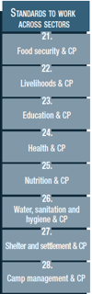









Pillar 4 – description of the Standards
St. 21: Food Security & CP
Integrated approach to promote well-being and protection
Coordination and complementarity
St. 22: Livelihoods & CP
Reduction in the use of risky or harmful coping mechanisms
St. 23: Education & CP
Participatory, inclusive, positive discipline and gender-sensitive approaches
Safe & inclusive environnements
Notes:
[Below are the key points of each standard. Depending on your public, their specific area of interest, your programming priorities, your context or the time you have to facilitate, you may want select only one or two keys standard under each pillar. There is a separate, short set of slides for each Standard]
READ OUT
Standard 21: Food Security & Child Protection
Food insecurity increases child protection risks and the possibility of choosing negative coping strategies such as child marriage, child labour or even neglect. Specific actions can be integrated within each of the four food security pillars – availability, accessibility, stability and utilisation – to support children’s well-being and protection.
This standard outlines a systematic, integrated approach between the food security and child protection sectors that is based on coordination and complementarity.
Icon: Many linkages w/ Safeguarding: safeguarding principles to all forms of assistance; training on safeguarding procedures, codes of conducts and protection from sexual exploitation and abuse (PSEA) policies; joint, child-friendly, accessible and confidential feedback and reporting mechanisms for child protection concerns as part of Accountability to Affected Populations (AAP). [→ the safeguarding icon]
Encourage CP actors to read over the in-depth Food Security guidance found in the Sphere standards. https://handbook.spherestandards.org/en/sphere/#ch007
Standard 22: Livelihoods & Child Protection
‘livelihood’ = capabilities, assets, opportunities and activities to be able to make a living
When a family’s capacity to provide adequate food, shelter, education and care is reduced, children can be at risk of all forms of child protection concerns. Economic recovery and livelihoods interventions can have then a significant protective impact on children: the likelihood that the household will make choices that are harmful to children when trying to meet their food needs is reduced when incomes are stable.
Icon: focus on targeting economic recovery and livelihoods interventions at caregivers and older children of working age [→ the Adolescent icon] . We have to think about the traditional stereotypes, obstacles related to gender or cultural norms around appropriate work for genders or groups (and their links with economic dependence on others, exclusion from formal jobs, exploitative, informal work environments & abusive relationships…)
Encourage CP actors to read over the in-depth Livelihoods guidance found in the MERS standards. https://handbook.spherestandards.org/en/mers/#ch001
Standard 23: Education & Child Protection
A lack of access to education has direct negative impacts on children’s well-being and development. Children who are out of school can face greater child protection risks. Child protection concerns can prevent children from accessing education or can decrease educational outcomes. Both education and child protection actors target children in and/or out of formal education/schools, so most activities are conducted jointly
This standard outlines how education and child protection actors can work together more systematically, based on complementarity, to support children’s well-being. Appropriate approaches (like participatory, inclusive, positive discipline and gender-sensitivity) should align with both child protection and education minimum standards and be adapted in-country.
Learning centers should aim at meeting ‘Safety criteria’, that are determined in-country and could include: safe and secure infrastructure, location cleared of explosive ordnance (EO), appropriate facilities, sufficient space, accessibility (both in and around the learning centre), and inclusive environments (in terms of location, gender, language, race, religion, learning environment).
For in-depth education guidance, refer to the INEE Minimum Standards.
All key actions in this standard apply to both sectors’ actors.
[Facilitators – if you have a few minutes, try to inject some fun into the session! It helps the participants feel more comfortable with the handbook itself. You may not have time for all of the activities suggested into this presentation]
Discussion Prompt: → Discuss the linkages between Education & Prevention / Safeguarding/Adolescence/Refugee & Infectious Disease Outbreaks contexts, by seeking the icons in St 23 in the handbook

Slide 9




Pillar 4 – description of the Standards
St. 24: Health & CP
Characteristic of integrated approach
Identification
Child Friendly services
St. 25: Nutrition & CP
Population & vulnerability
Opportunities:
  Referrals
  CP focal points
  Multi-use spaces …
Notes:
READ OUT
[Below, key points from each standard. Depending on your public, their specific area of interest, your programming priorities, your context or the time you have to facilitate, you may want select only one or two keys standard under each pillar]
Standard 24: Health & Child Protection
Supporting children’s health increases their protective factors, while supporting children’s protection can, and should, improve their physical health and well-being. An integrated approach to health and child protection should be : Safe; Protective; Inclusive; Systematic; Complementary; Valid for all sectors; and Participatory
Healthcare workers should be trained on identification of children affected by abuse, neglect, exploitation or violence (including physical, psychological and emotional signs of them).
It is important to implement accessible, trauma-sensitive and child-friendly procedures, services and communication when admitting, treating and discharging children
Icons:
An integrated approach to health and child protection should include a coordination systems to allow referral mechanisms, safe and confidential protocols and information sharing between the two sectors [→ the case management icon]
Many linkages with prevention, by including concerns, principles and approaches so actors can correctly prevent, identify, and/or mitigate child protection cases, and avoid family separation during referrals and admissions.
This standard is also especially relevant in Infectious Disease Outbreaks!
Encourage CP actors to read over the in-depth Health guidance found in the Sphere standards: HSPapp or https://handbook.spherestandards.org/en/sphere/#ch009
Standard 25: Nutrition & Child Protection
Nutritional imbalances often worsen in times of crisis when caregivers struggle to provide food, income and health care for their families. Family separation may become more likely. Children or caregivers may leave to find paid work, including hazardous labour, may drop out of school and lose peer support. Families may place their children in residential care so that their children can access food.
Nutrition and CP target similar groups that are especially vulnerable: Child-headed households; Children without parental care or separated from their families; Pregnant and lactating mothers under the age of 18 year; s Children with disabilities; Children showing signs of physical, sexual abuse; Children showing signs of mental distress; Children under the care of a parent/guardian experiencing mental distress; Children under the care of a parent/guardian unable to care for them etc
[→ the Adolescent / Infant icon] show linkage in programming, i.e: infant and young child feeding (IYCF) support; breastfeeding classes and peer support groups for pregnant adolescents
There are many opportunities to integrate approaches, including:
Joint case management;
Referrals of children in need of services to health facilities and nutritional feeding centres
Holistic support for accessible services;
Encouragement for appropriate care and nurturing;
CP Focal points in supplementary or therapeutic feeding centres
Joint programmes with therapeutic, supplementary or blanket feeding and positive parenting; and
Multi-use spaces that meet both sectors’ needs.
Encourage CP actors to read over the in-depth Food Security/ Nutrition guidance found in the Sphere standards: HSPapp or https://handbook.spherestandards.org/en/sphere/#ch007

Slide 10



Pillar 4 – description of the Standards
St. 26: WASH & CP
WASH practices, services, facilities & interventions, adapted to the needs of children
St. 27 : Shelter & CP
Safety, well-being & privacy criterias into shelter and settlement interventions
St. 28 : CCCM & CP
Access to life-saving assistance and protection services
Child participation
Safety and security incident monitoring & referrals
Safe living environments = dignity, security and livelihoods
Appropriate shelter = safety, protection and accessibility
Notes:
READ OUT
[Below, key points from each standard. Depending on your public, their specific area of interest, your programming priorities, your context or the time you have to facilitate, you may want select only one or two keys standard under each pillar]
Standard 26: WASH & Child Protection
Child protection staff should guide and advise water, sanitation and hygiene (WASH) staff so they are able to deliver safe and appropriate WASH practices, services, that are adapted to the needs of children. I.e: accessible and child-friendly WASH facilities. For this, child safety and well-being has to be reflected in the initial risk analysis, design, and monitoring and evaluation framework.
Icons: all WASH workers (including subcontractors’ staff) and child protection staff should be trained on and sign safeguarding policies and procedures. Samewise, the way WASH programmes are designed, planed and implemented have a great prevention potential, i.e: prioritisation criteria, support & refer households/children at risk, safe, accessible, inclusive facilities…
Encourage CP actors to read over the in-depth WASH guidance found in the Sphere standards : HSPapp or https://handbook.spherestandards.org/en/sphere/#ch006
Standard 27: Shelter and settlement & Child Protection
Child protection must be integrated into shelter and settlement interventions, from design to monitoring and evaluation, especially to take into account :
Family size, unity and composition
Children at risk, like children living alone or in new or altered family units
Accessibility for children with disabilities & barriers to access essential services
Protection risks & social norms
Local land and property rights to decide on where, how and to whom shelter is provided
Need for adequate indoor and outdoor play spaces, materials and shelter units to help reducing CP risks
Safety & privacy criterias
Shelter programming has direct protection outcomes :
- Providing safe living environments (wider locations where people and communities live) allow people to live with dignity, security and livelihoods
Providing appropriate shelter (household living space) promote safety, protection and accessibility. I.e: privacy for adolescent girls, addressing physical dangers and safe routes for accessing schools [→ the adolescent and prevention icons]
Encourage CP actors to read over the in-depth Shelter guidance found in the Sphere standards: HSPapp or https://handbook.spherestandards.org/en/sphere/#ch008
Standard 28: CCCM & Child Protection
Main goal of camp management is to support equitable and dignified access of refugee, internally displaced and migrant populations living in temporary settlements (including camps, collective/evacuation centres and spontaneous settlements) to life-saving assistance and protection services. All children have the right to access educational facilities, health care, psychosocial services, recreational opportunities and religious activities that meet their individual needs.
Child protection and camp management actors need to collaborate to ensure children’s meaningful participation, in the design, monitoring and adjustment of programmes and in representation mechanisms in the camp management structures
Camp management should monitor & refer security concerns and safety incidents (sexual and gender-based violence, abductions, physical attacks, child labour and other dangers - explosive ordnance, drowning or fire, poor
lighting or secluded wáter points/latrines that result in incidents of
sexual violence), and organize risk mitigation activities accordingly (i.e appropriate lighting, patrolling firewood collection routes, monitoring school routes, marking areas contaminated by explosive ordnance or fencing off areas with open water) [→ the prevention icon]
Encourage CP actors to read over the in-depth CCCM minimum standards: HSPapp or https://handbook.spherestandards.org/en/camp/#ch001

Slide 11

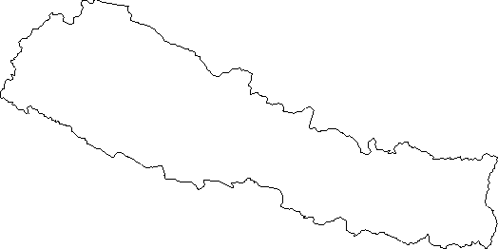

Examples from the Region
[COUNTRY NAME]
Add key presentation sentence about a specific program/project using Pillar 2
Add name of organisations
Add key message / numbers
[ COUNTRY NAME]
Add key presentation sentence about a specific program/project using Pillar 2
Add name of organisations
Add key message / numbers
[ COUNTRY NAME]
Add key presentation sentence about a specific program/project using Pillar 2
Add name of organisations
Add key message / numbers
Notes:
Depending on the time you have for facilitation, consider adding here examples from the Region/ Country/ Response, of programming that meets the standards.
This could be a draft slide that you could update or remove if necessary.
For each example, you could add:
A short, concise, key presentation sentence about the specific program/project using Pillar 3
Add the name of organisations and partners involved
Add practical lessons learnt, key actions, message or numbers, that will attract interest of your audience
Another option, if you have longer (and also depending on the audience you have), this slide can be completed in an interactive way during the session.
In that case, you could:
split into 2 or 3 smaller groups,
allow 15 – 20 min for them to prepare a short presentation of an example from the Region/ Country/ Response, of programming that meets the standard
in plenary, have the groups present their examples, and discuss /compare lessons learnt out of them.
If you will be sending this presentation to the participants after the training, you can fill up this slide, to keep records of the presentations.
TIP: you can use https://thenounproject.com/ to get map outlines like those.

Slide 12
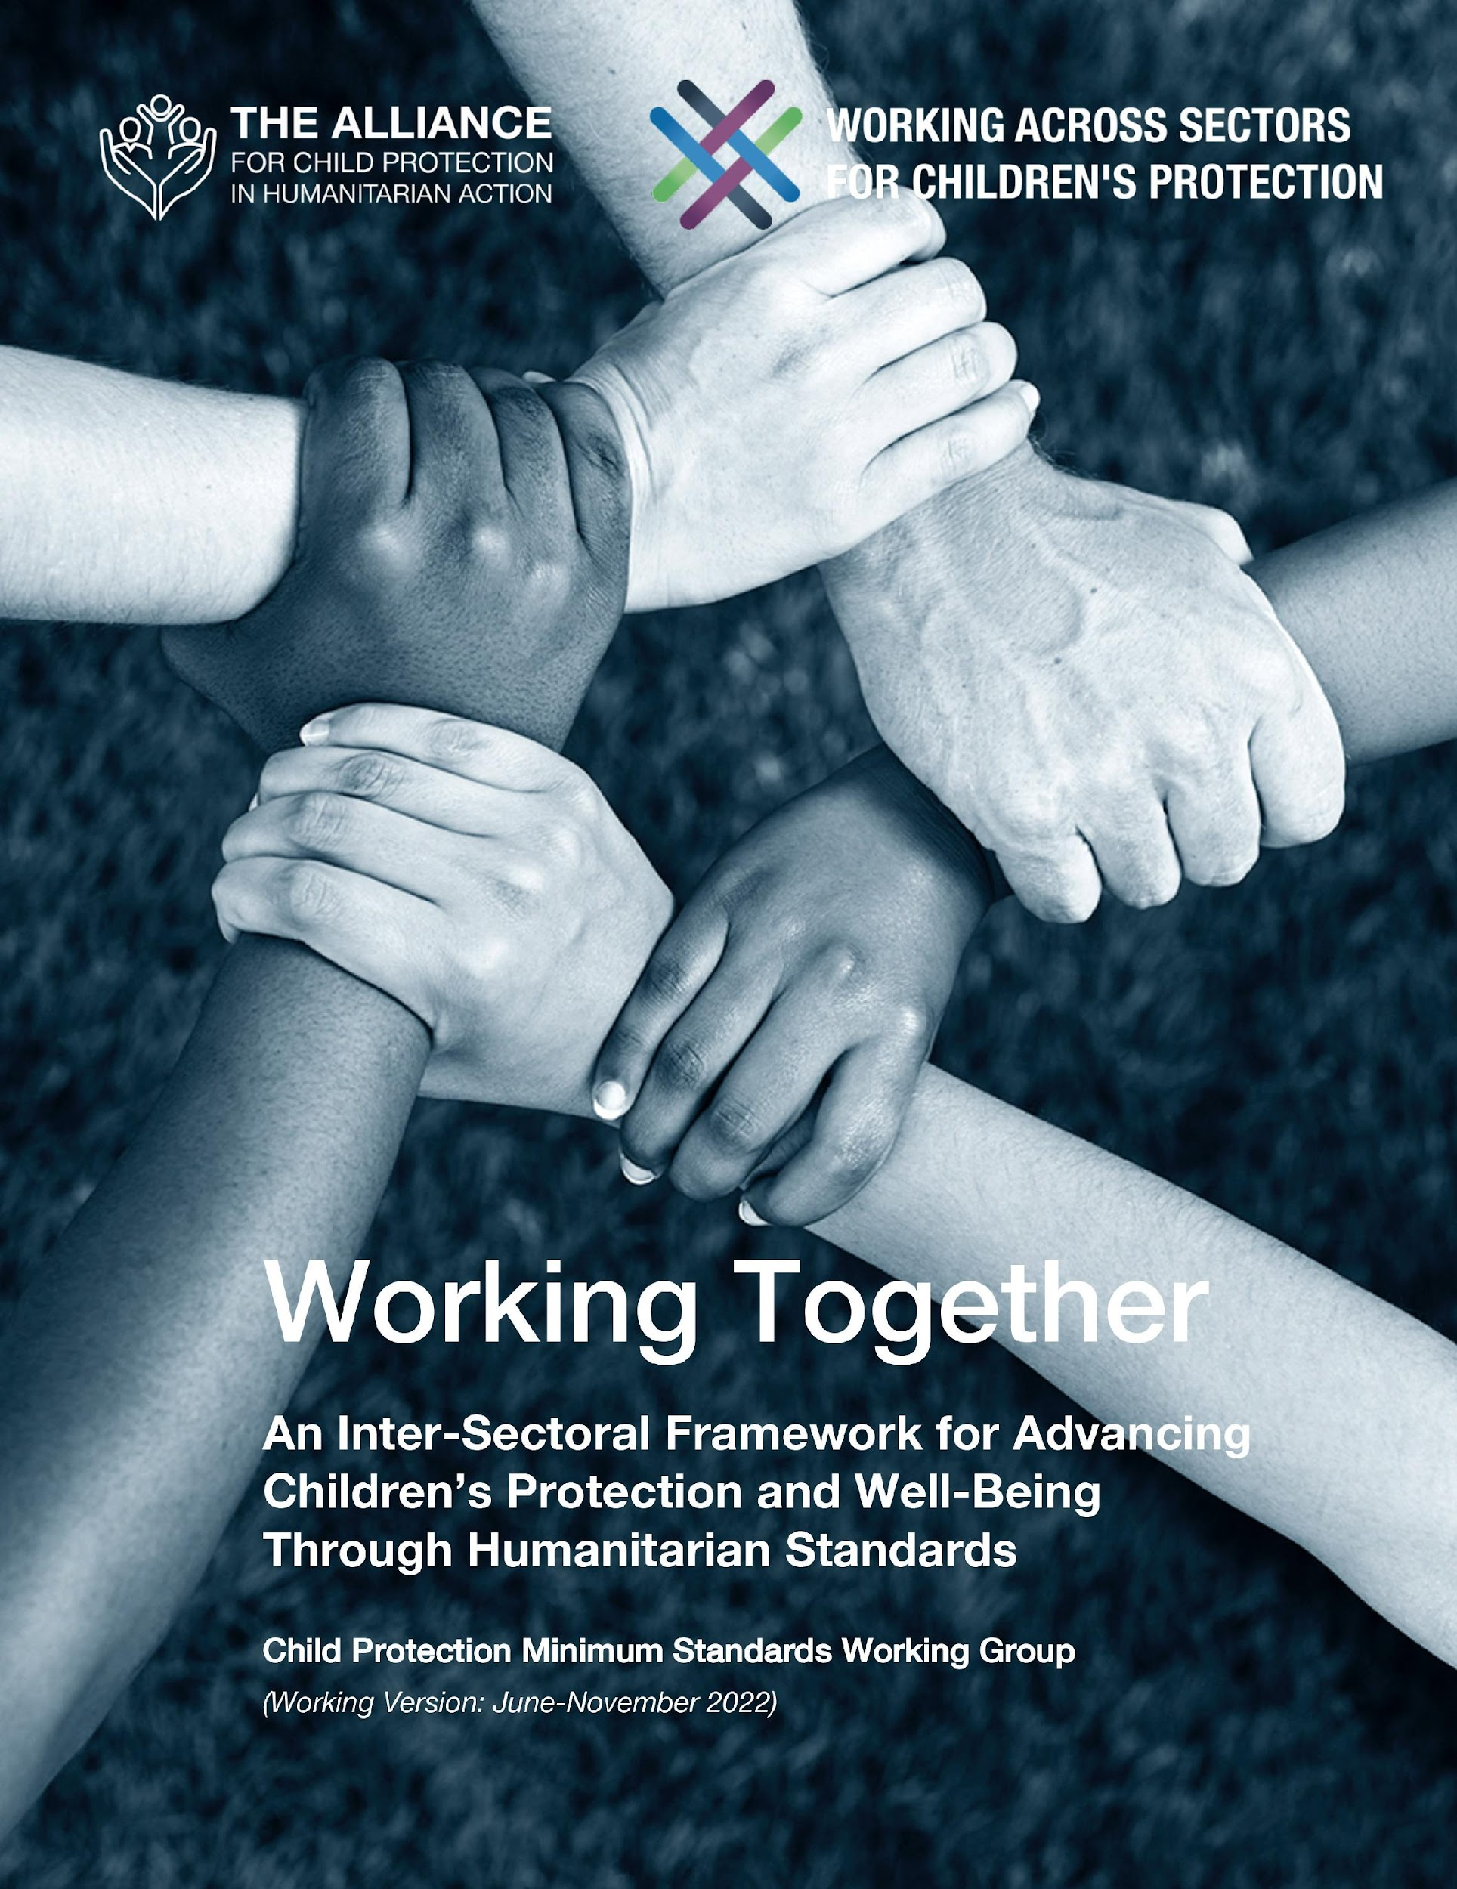
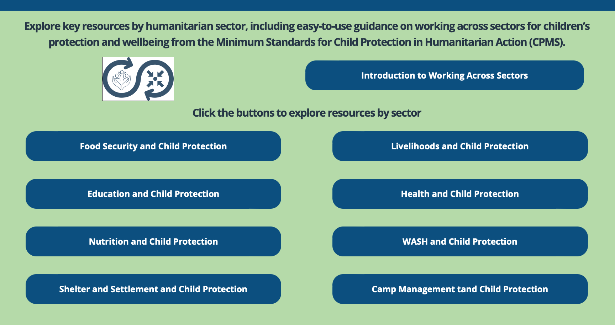
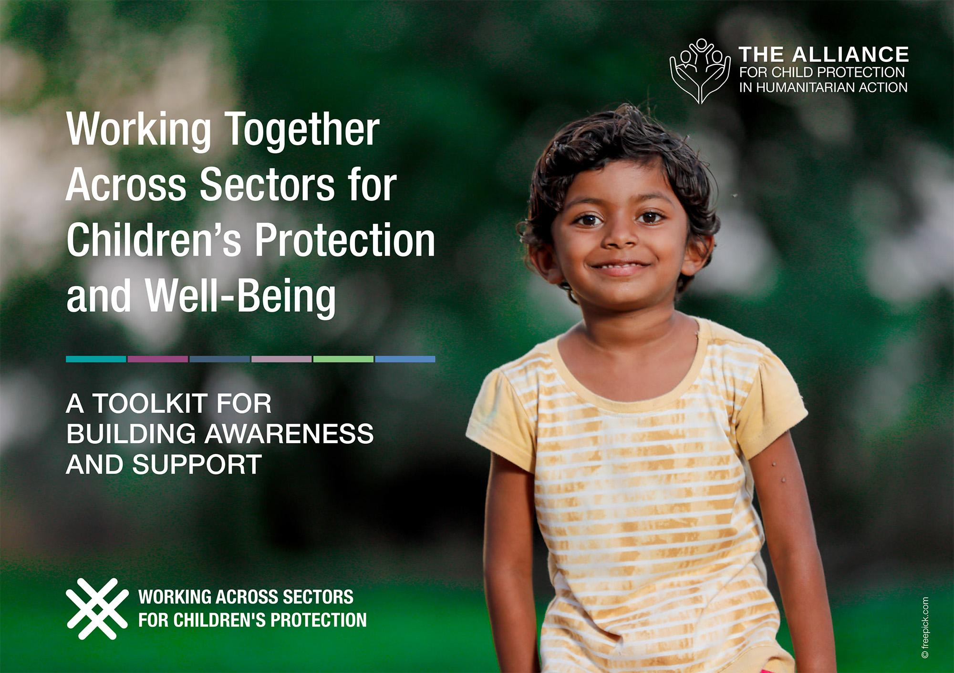
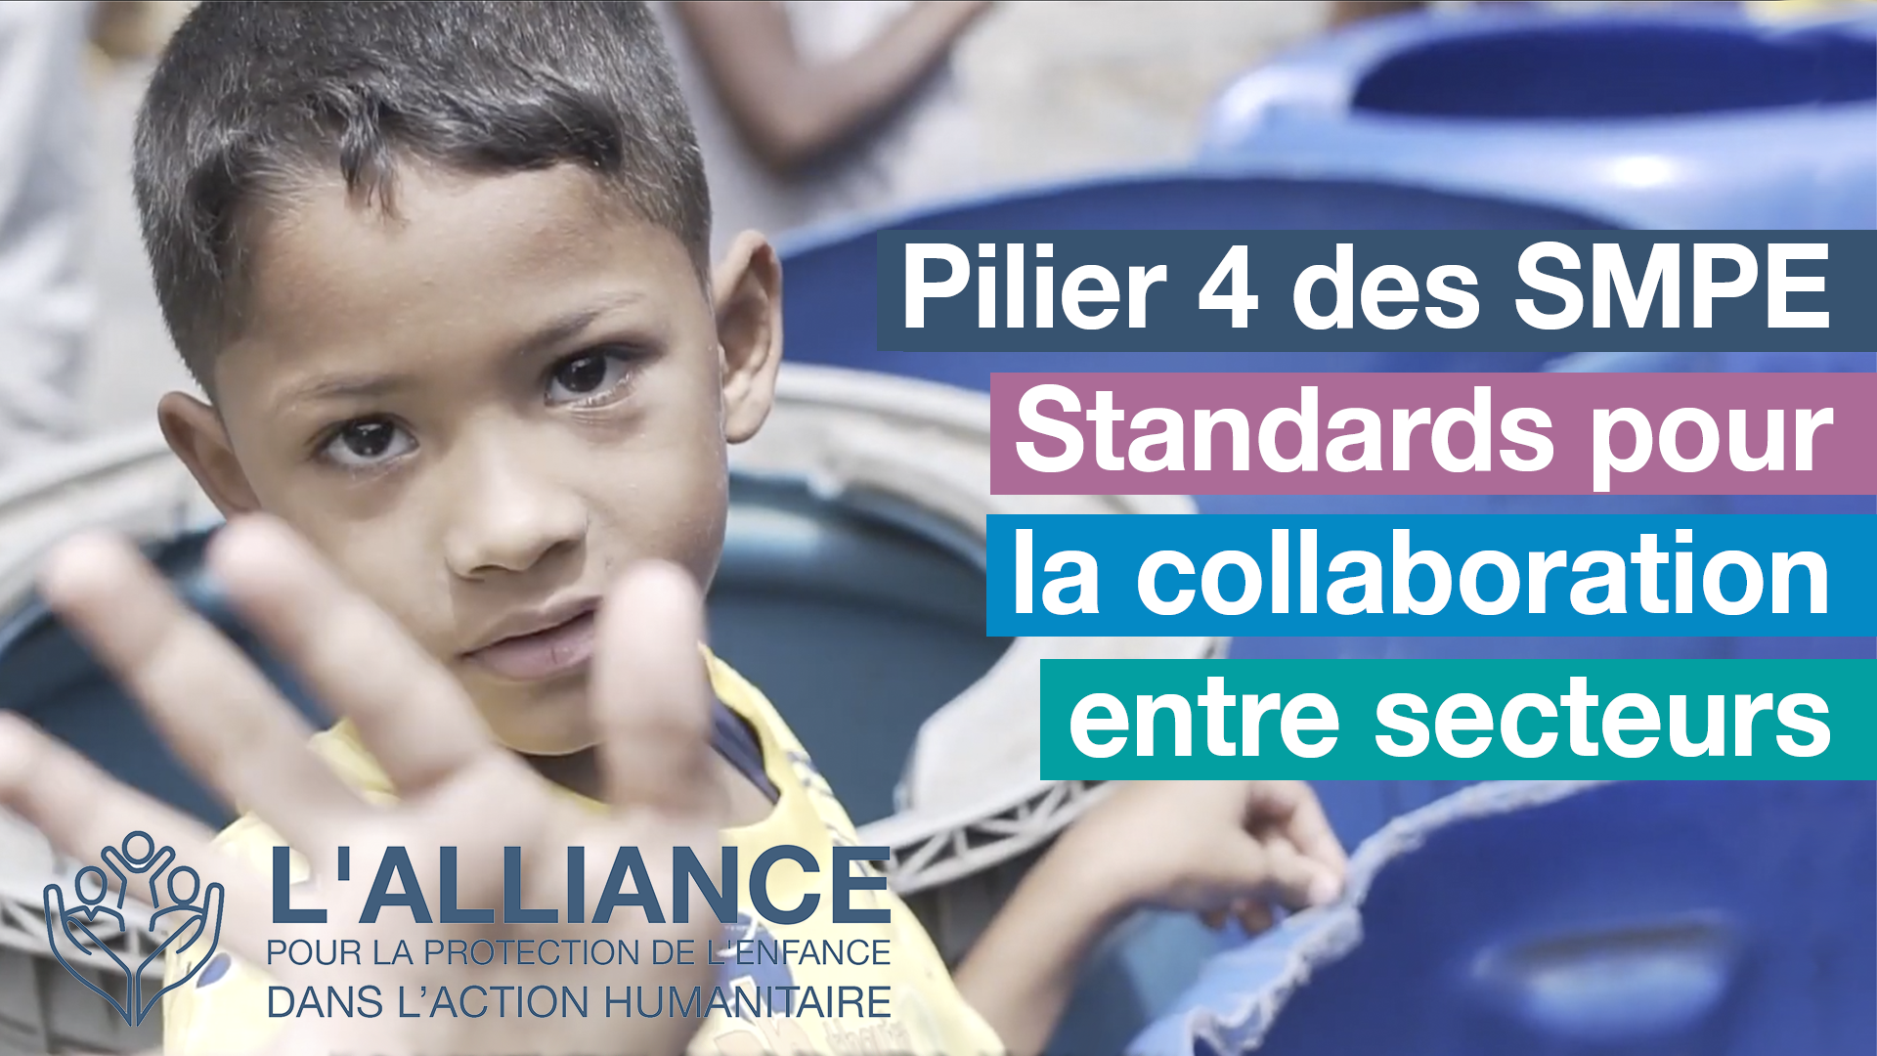
Improving together
https://alliancecpha.org/en/workingtogether
Notes:
The Child Protection sector is committed to improving how it works alongside others for better protection outcomes for children.
CLICK: Working Together is an inter-sectoral framework to promote children’s protection and well-being using humanitarian standards. It is a “living document” that was created through a large-scale, consultative process,. The global CPMS Working Group updates it every 6 months. Currently, the prioritized sectors are: health, education, Food Security, and Camp Coordination and Camp Management.
CLICK: For more news, learning opportunities and resources, check out the Alliance for Child Protection in Humanitarian Action’s microsite for the global Working across Sectors initiative and the sector-specific resource folders.

Slide 13


Need more than the hard copy?
On the Alliance website
  PDF version
  Briefing & Implementation Pack
  25-page Summary
  E-course
  YouTube videos
  A gallery of illustrated Standards
  👉 www.AllianceCPHA.org
  On the Humanitarian Standards Partnership website
  Online, interactive version
  HSP App for mobile phones and tablets
👉 www.HumanitarianStandardsPartnership.org
Notes:
[Facilitators - if you can project from the internet, then we suggest you navigate people there and show them]
Alliance website.
The PDF & all materials available can be downloaded if people want to print just portions of the CPMS, on the Alliance site
The “Introduction to CPMS” Briefing Pack contains this PPT and facilitation notes, plus the 2 page Introduction handout.
A Summary: At just 32 pages, it means that it is very topline but can be used to introduce the idea of minimum standards or start child protection discussions with government colleagues or other humanitarians without overwhelming them with the huge handbook.
Discover our free CPMS e-course with a range of modules
Videos on the Alliance Youtube channel
A gallery of illustrated Standards
HSP:
1. Online handbook
2. The Humanitarian Standards Partnership App
– It is the 2nd most popular app on that site after Sphere
ASK: What should our next steps as a team/agency/individual be?
(i.e. you might schedule a longer meeting to digest the changes and create a plan; or ask colleagues to present certain new/revised standards and their implications for the programme; or set up a training or ask Senior Management for a meeting to discuss accountability to children, etc)
[Facilitators - Printed copies – there is a small stockpile of the Handbook and Summary that the global Alliance has in Geneva; however, countries and regions are encouraged to print & manage their own copies locally. Usually, this would be done through the inter-agency Coordination structure. On request, the Alliance can share a print-ready PDF.]
Thank you so much for coming together and starting to explore the CPMS. I will follow up on the next steps we discussed. And that’s the key – the CPMS is a gift that just keeps on giving every time you open it!

