Slide 1
The Minimum Standards for Child Protection in Humanitarian Action
CPMS
SLIDE DECK
Notes:
Facilitators:
This briefing is for any potential user of the CPMS. It is geared primarily toward child protection staff, so consider broadening some questions or providing more detail, if colleagues from other sectors join you.
It is assumed that the group is about 20 people and that everyone in the room knows each other (perhaps colleagues from your agency or the CP coordination group). if not, add 5 minutes for quick introductions.
PREPARE: a flipchart with the objectives of the session
By the end of the session, participants will be able to:
Describe the content of Standard 28
Explain & Share its key messages
Demonstrate how & why to use the handbook
NOTE: if you have already done a Session on Pillar(s), Principles or other Standard(s), skip slide 2 & 7
TIP: Slides are animated -> for each click you’ll make, some few words, a title or an image will appear on the slide.
Read the corresponding notes from the facilitators notes, before showing the following content, so participants have time to process what you say, and read each point.

Slide 2



Aim of the Standards
Benchmark for CPHA.
Collaborative, inter-agency tool
Links with Core Humanitarian Standard
Contextualisation for local ownership
Purpose:
  quality and accountability
  impact for children’s protection and well-being
Notes:
Donors, local governments, colleagues in other sectors and our beneficiaries themselves want to know what we are doing and why. The CPMS is our benchmark. They are the key way to operationalise or make real children's rights in the practice of humanitarian response.
They are a collaborative, inter-agency tool, that links with other initiatives, such as the Core Humanitarian Standard and the Humanitarian Inclusion Standards
Wherever relevant, the CPMS align with INSPIRE’s 7 strategies to end violence against children – initiative’s icons are actually scattered through the text. In addition, the Core Humanitarian Standard on Quality and Accountability is highlighted in the Introduction and resonates throughout the handbook.
Contextualisation is encouraged and can create ownership of the standards at every level. It builds a deeper understanding of child protection in the specific context for a wide range of actors. National coordination groups are therefore encouraged to adapt the CPMS. Please raise it with colleagues locally and then seek the guidance of the global CPMS team. For more information, watch the short contextualization video on the Alliance’s youtube channel.
BOX: The CPMS aim at improving the quality and accountability of our programing and increasing impact for children’s protection and well-being in humanitarian action (internal displacement and refugee contexts), by establishing common principles, evidence, prevention and goals to achieve. They provide a synthesis of good practice and learning to date.

Slide 3

Overview
Notes:
This is an overview of the CPMS structure: there are 28 Standards across 4 pillars and 10 CPHA principles threaded throughout.
You can find this overview on the back of the CPMS handbook or in the online handbook; it’s a practical way of locating quickly a specific topic.
This presentation focuses on Standard 28: Camp Management & Child Protection

Slide 4
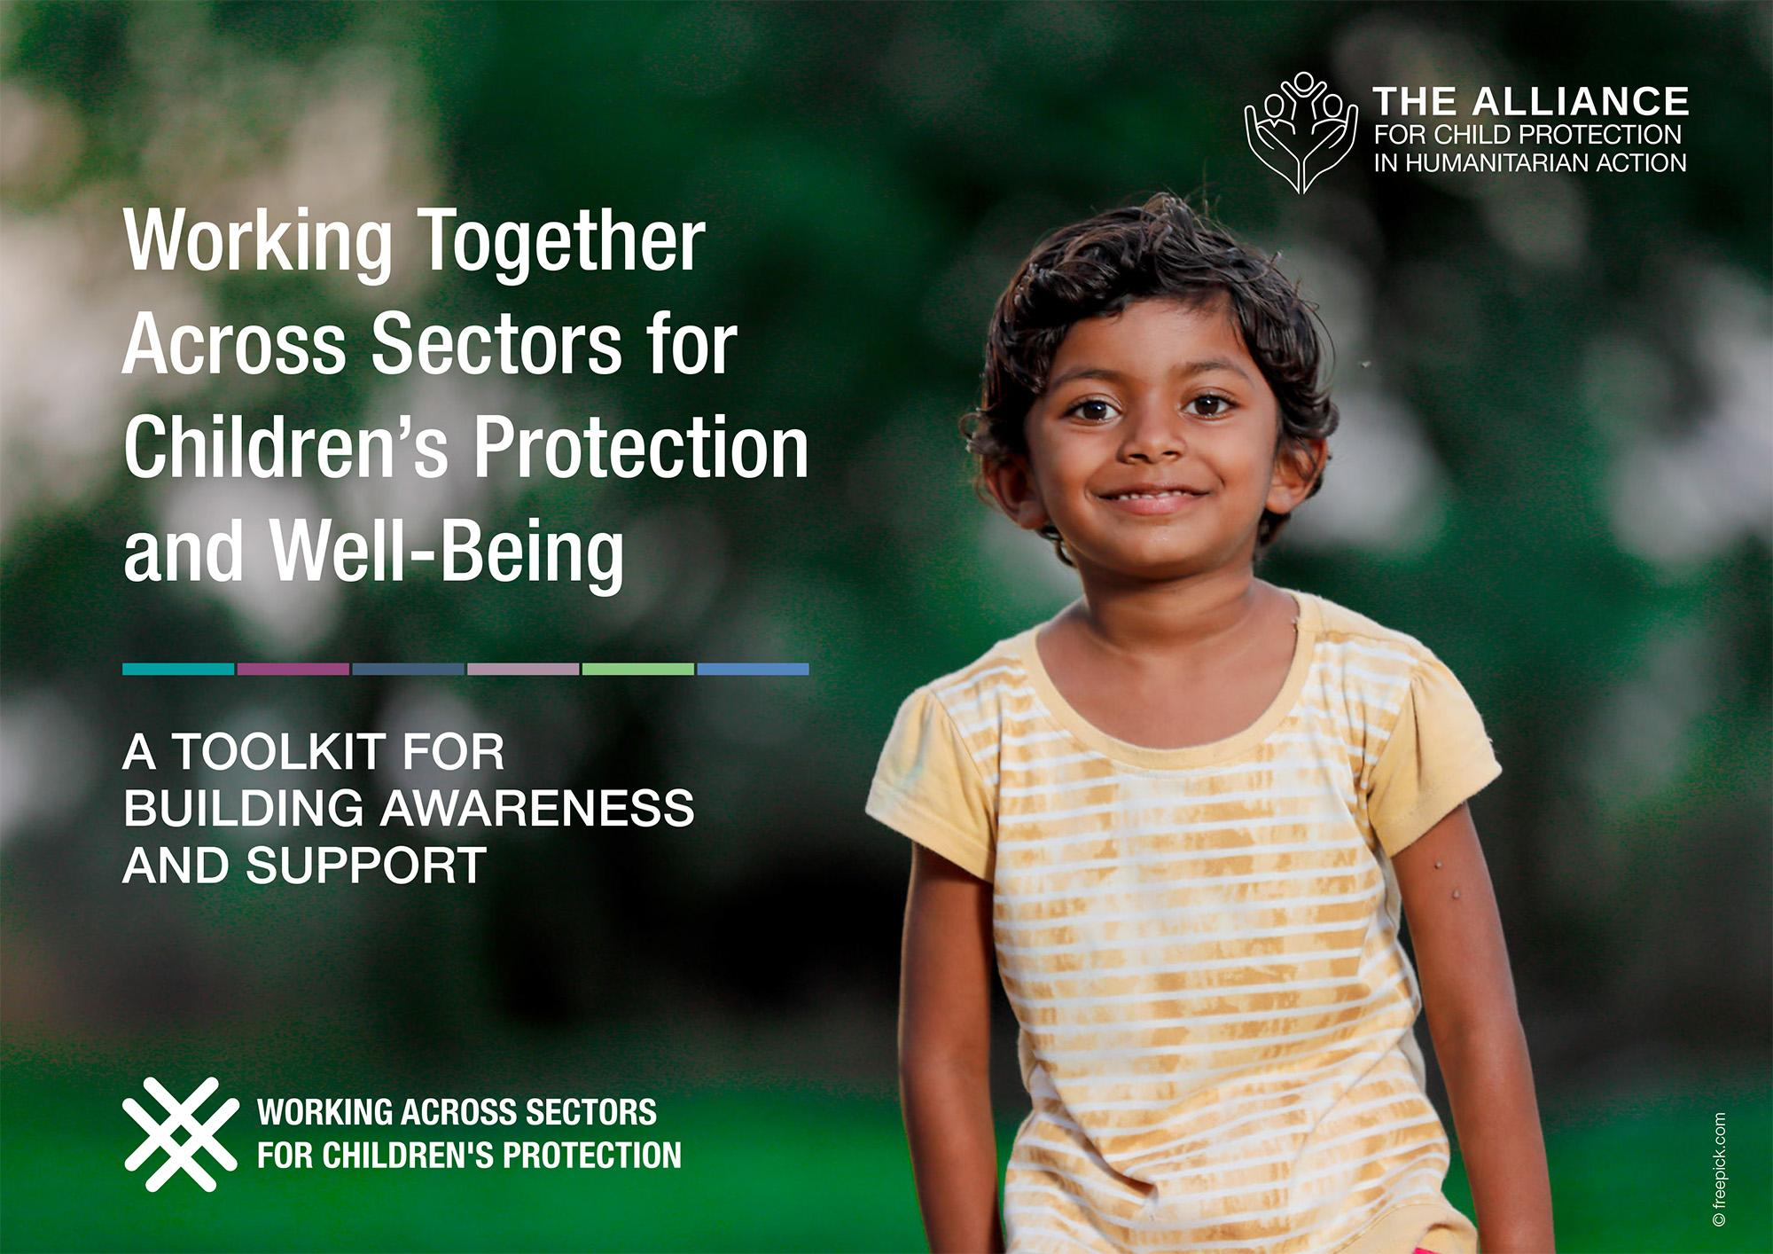
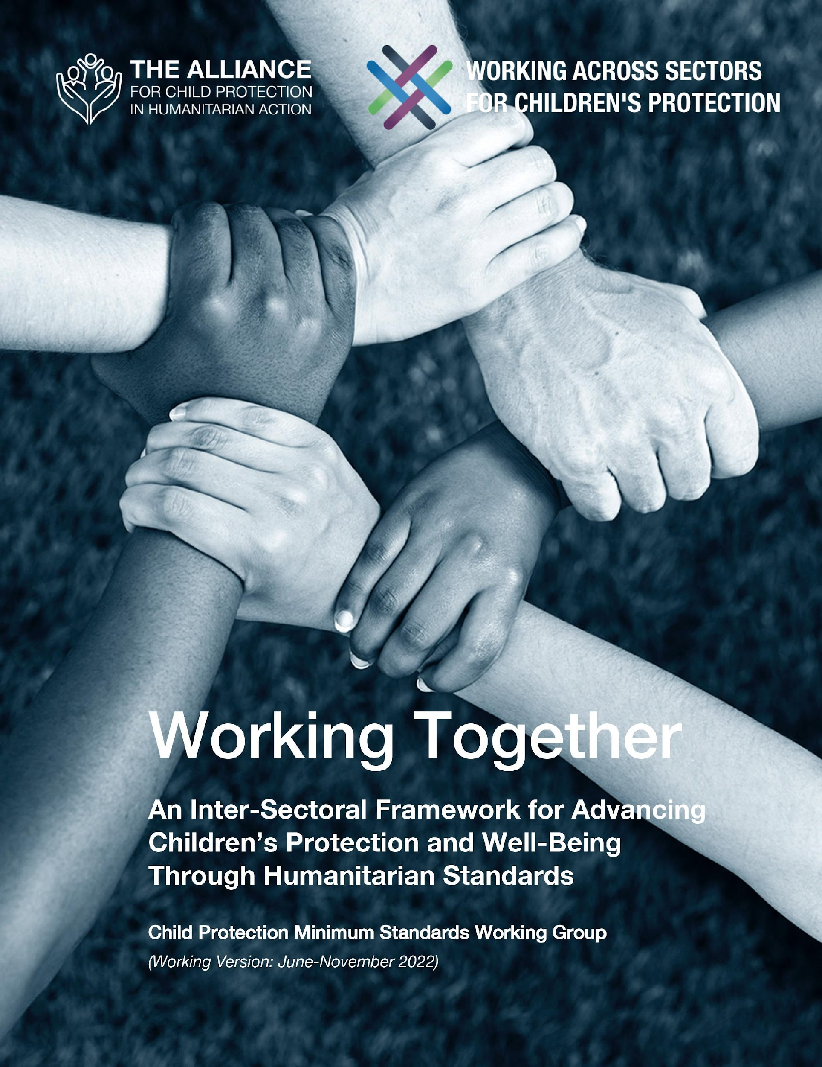

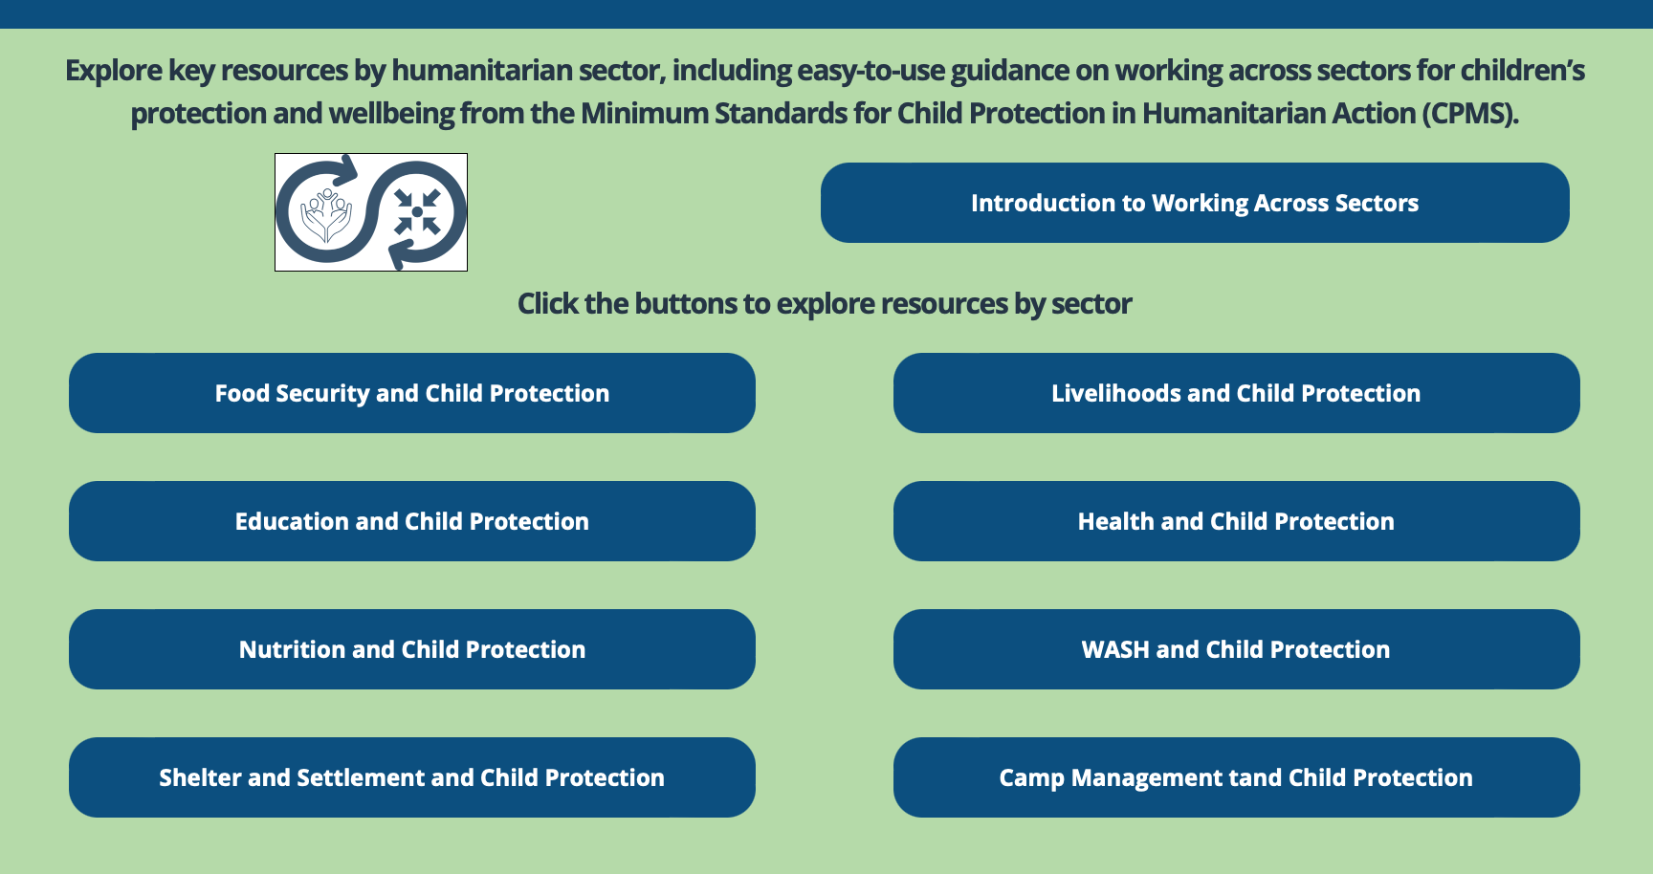

Working Together
Interconnected needs of children
Collective responsibility = Centrality of Protection
Higher-quality impact
Notes:
The CPMS have a complete section devoted to Child Protection personnel working with and learning from other humanitarian actors to improve protection and well-being outcomes for children.
CLICK: Multisectoral approaches reflect the interconnected needs of children and emphasise
CLICK: all humanitarian actors’ collective responsibility to protect children and their families. Children’s protection risks are closely linked with the work of humanitarian actors because they have needs that fall under all sectors.
CLICK: Multisectoral programming - that includes and addresses child protection considerations (such as children’s particular risks, vulnerabilities, developmental stages, etc.) can be an effective way to achieve real, higher quality outcomes for both / all sectors.
CLICK: Working Together is an inter-sectoral framework to promote children’s protection and well-being using humanitarian standards. It was created through a large-scale, consultative process, and is updated every 6 months. Currently, the prioritized sectors are: health, education, Food Security, and Camp Coordination and Camp Management.
CLICK: Check out the microsite for the global Working across Sectors initiative and the sector-specific resource folders.

Slide 5



An introduction to Standard 28
Interconnected needs of children
Collective responsibility = Centrality of Protection
Higher-quality impact
Access to life-saving assistance and protection services
Child participation
Safety
Notes:
This Standard is part of the fourth Pillar of Standards related to Working across Sectors.
Multisectoral approaches reflect the interconnected needs of children and emphasise all humanitarian actors’ collective responsibility to protect children and their families. Child protection risks are closely linked with the work of other sectors because children have needs that fall under all sectors.
One very effective way towards real & higher quality impact is multisectoral programming that includes and addresses child protection considerations (such as children’s particular risks, vulnerabilities, developmental stages, etc.).
Main goal of camp management is to support equitable and dignified access of displaced populations living in temporary settlements (including camps, collective/evacuation centres and spontaneous settlements) to life-saving assistance and protection services. Camp management actors work in close coordination with other sectors, including Child Protection and Education, to ensure that children’s rights are fulfilled and that they have access to essential services (educational facilities, health care, psychosocial services, recreational opportunities...)
Child protection and camp management actors need to collaborate to ensure children’s meaningful participation, in the design, monitoring and adjustment of programmes and in representation mechanisms in the camp management structures to ensure that they have a voice and can express their needs, concerns and aspirations, and that challenges they are facing are being addressed collaboratively by concerned sectors
Camp management contributes to monitor security concerns affecting children living in temporary settlements, and help designing and coordinating the implementation of risk mitigation activities in close collaboration with concerned [🡪 the prevention icon]

Slide 6




Joint Actions
“Camp management activities address the needs and protection concerns of children affected by forced displacement.”
Equal access to services
Site planning & improvement
Two-way communication systems
CP risks identification
Risk mitigation activities
Can you give examples of risk mitigation activities?
Notes:
Standard 28 states: “Camp management activities address the needs and protection concerns of children affected by forced displacement.”
Camp management actors can monitor the inclusion and accessibility of camp services by conducting regular spot-checks and help analyzing trends and identify challenges in access to services, looking at various characteristics including the age, gender and disability of persons accessing assistance. They may similarly play a key role to ensure equal access to critical information for all persons living in temporary sites, and devise specific strategies to ensure outreach to persons likely to be excluded from usual communication channels.
It is critical for camp management and child protection actors to jointly consider how they will meet children’s need for safe, accessible spaces to learn and play in temporary settlements. This collaboration should begin at the earliest stages of site planning and continue throughout any site improvement processes. Proper planning prevents children’s spaces from being located in dangerous locations (open water plans, ditches/drainage, isolated areas) or excluded altogether due to lack of available space.
Child protection and Camp Management actors also need to collaborate to establish two-way communication systems for children, including feedback and reporting mechanisms, to regularly collect their feedback and understand their concerns, and using appropriate methods adapted their needs. (note: it is likely that specific measures will need to be put in place by CM and CP for that purpose, as common tools are usually not adapted to children)
Child Protection and camp management should also conduct periodic joint safety and accessibility audits of infrastructures and services on site and collaborate on risk and/or safety child protection assessments to identify child protection risks and implement risk mitigation activities addressing needs identified in displacement sites
Discussion Prompt: Can you give examples of risk mitigation activities?
-> I.e: placing appropriate lighting in areas frequently used by women and children (both girls and boys), patrolling firewood collection routes, monitoring and taking action to increase safety on school routes, fencing off areas with open water or identified areas contaminated by explosive ordnance, training of camp management staff on child protection principles and concerns, on safe referrals; advocacy for the provision of civil documentation by relevant authorities, set-up of representative participation structures, etc.

Slide 7

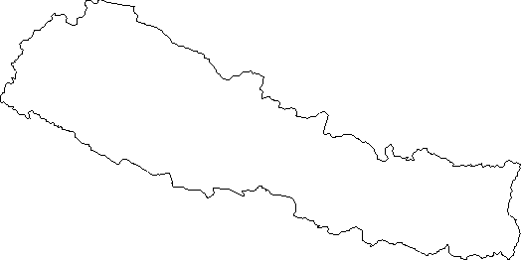

Examples from the Region
[COUNTRY NAME]
Add key presentation sentence about a specific program/project using Standard 28
Add name of organisations
Add key message / numbers
[ COUNTRY NAME]
Add key presentation sentence about a specific program/project using Standard 28
Add name of organisations
Add key message / numbers
[ COUNTRY NAME]
Add key presentation sentence about a specific program/project using Standard 28
Add name of organisations
Add key message / numbers
Notes:
Depending on the time you have for facilitation, consider adding here examples from the Region/ Country/ Response, of programming that meets the standards.
This could be a draft slide that you could update or remove if necessary.
For each example, you could add:
A short, concise, key presentation sentence about the specific program/project using Standard 28
Add the name of organisations and partners involved
Add practical lessons learnt, key actions, message or numbers, that will attract interest of your audience
Another option, if you have a longer facilitation span (and also depending on the audience you have), this slide can be completed in an interactive way during the session.
In that case, you could:
split the groups into 2 or 3 smaller groups,
allow 15 – 20 min for them to prepare a short presentation of an example from the Region/ Country/ Response, of programming that meets the standard
in plenary, have the groups present their examples, and discuss /compare lessons learnt out of them.
If you will be sending this presentation to the participants after the training, you can fill up this slide, to keep records of the presentations.
TIP: you can use https://thenounproject.com/ to get map outlines like those.

Slide 8


Need more than the hard copy?
On the Alliance website
  PDF version
  Briefing & Implementation Pack
  25-page Summary
  E-course
  YouTube videos
  A gallery of illustrated Standards
  👉 www.AllianceCPHA.org
  On the Humanitarian Standards Partnership website
  Online, interactive version
  HSP App for mobile phones and tablets
👉 www.HumanitarianStandardsPartnership.org
Notes:
[Facilitators - if you can project from the internet, then we suggest you navigate people there and show them]
HSP:
1. Online handbook
2. The Humanitarian Standards Partnership App
– It is the 2nd most popular app on that site after Sphere
CPMS page:
1. Interactive handbook – our greatest resource
2. A Summary: At just 32 pages, it means that it is topline but can be used to introduce the idea of minimum standards or start child protection discussions with government colleagues or other humanitarians without overwhelming them with the huge handbook.
Alliance website:
The PDF & all materials available can be downloaded if people want to print just portions of the CPMS, on the Alliance site
The “Introduction to CPMS” Briefing Pack contains this PPT and facilitation notes, plus the 2 page Introduction handout.
A gallery of illustrated Standards
Discover our free CPMS e-course with a range of modules
Videos on the Alliance Youtube channel
ASK: What should our next steps as a team/agency/individual be?
(i.e. you might schedule a longer meeting to digest the changes and create a plan; or ask colleagues to present certain new/revised standards and their implications for the programme; or set up a training or ask Senior Management for a meeting to discuss accountability to children, etc)
[Facilitators - Printed copies – there is a small stockpile of the Handbook and Summary that the global Alliance has in Geneva; however, countries and regions are encouraged to print & manage their own copies locally. Usually, this would be done through the inter-agency Coordination structure. On request, the Alliance can share a print-ready PDF.]
Thank you so much for coming together and starting to explore the CPMS. I will follow up on the next steps we discussed. And that’s the key – the CPMS is a gift that just keeps on giving every time you open it!

